Slide 1
Machine Learning-Clustering
.

Slide 2
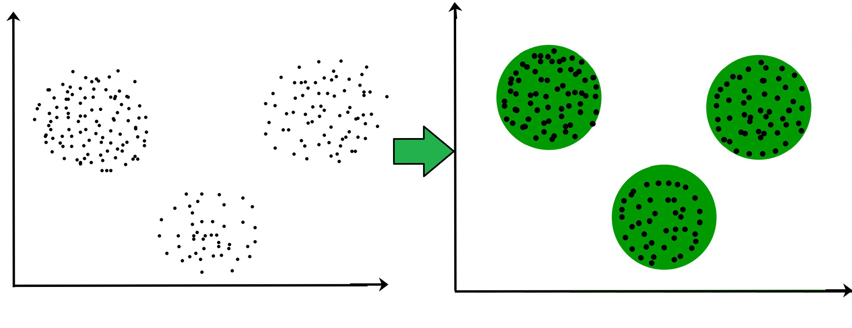
Clustering and its Types
The task of grouping data points based on their similarity with each other is called Clustering or Cluster Analysis. This method is defined under the branch of unsupervised learning ,which aims at gaining insights from unlabelled data points, that is, unlike Supervised learning.we don’t have a target variable.
Clustering aims at forming groups of homogeneous data points from a heterogeneous dataset. It evaluates the similarity based on a metric like Euclidean distance, Cosine similarity, Manhattan distance, etc. and then group the points with highest similarity score together.
For Example, In the graph given below, we can clearly see that there are 3 circular clusters forming on the basis of distance.

Slide 3
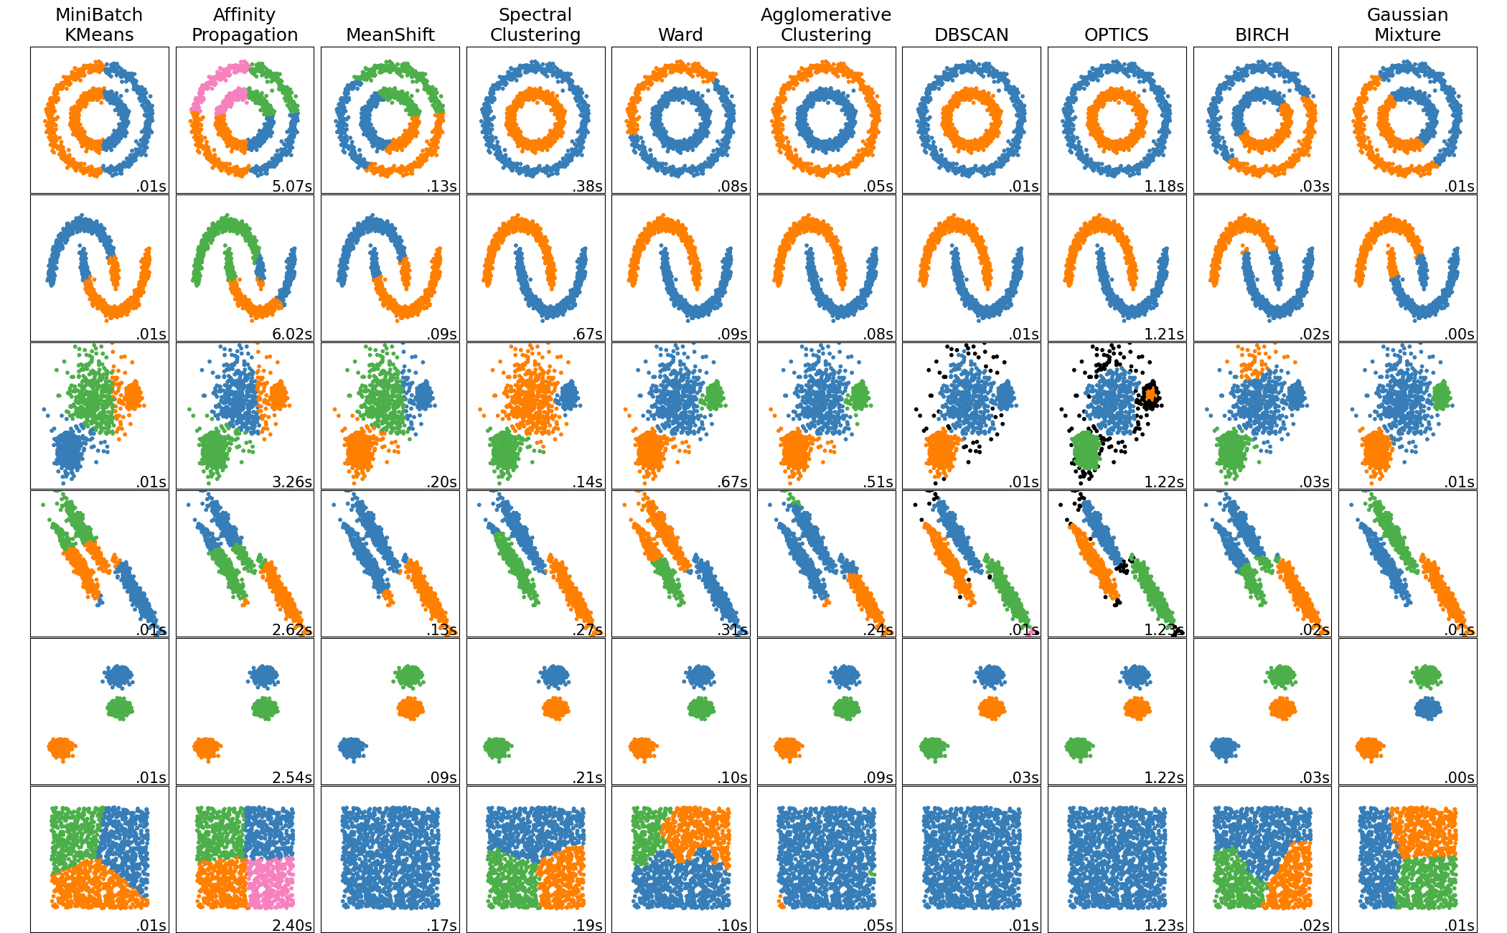
Types of clustering
K-means clustering
Hierarchial clustering
Affinity propagation clustering
Mean-shift clustering
Spectral clustering
Birch clustering
DBSCAN clustering
HDBSCAN clustering
Bisecting K-means clustering
OPTICS clustering

Slide 4
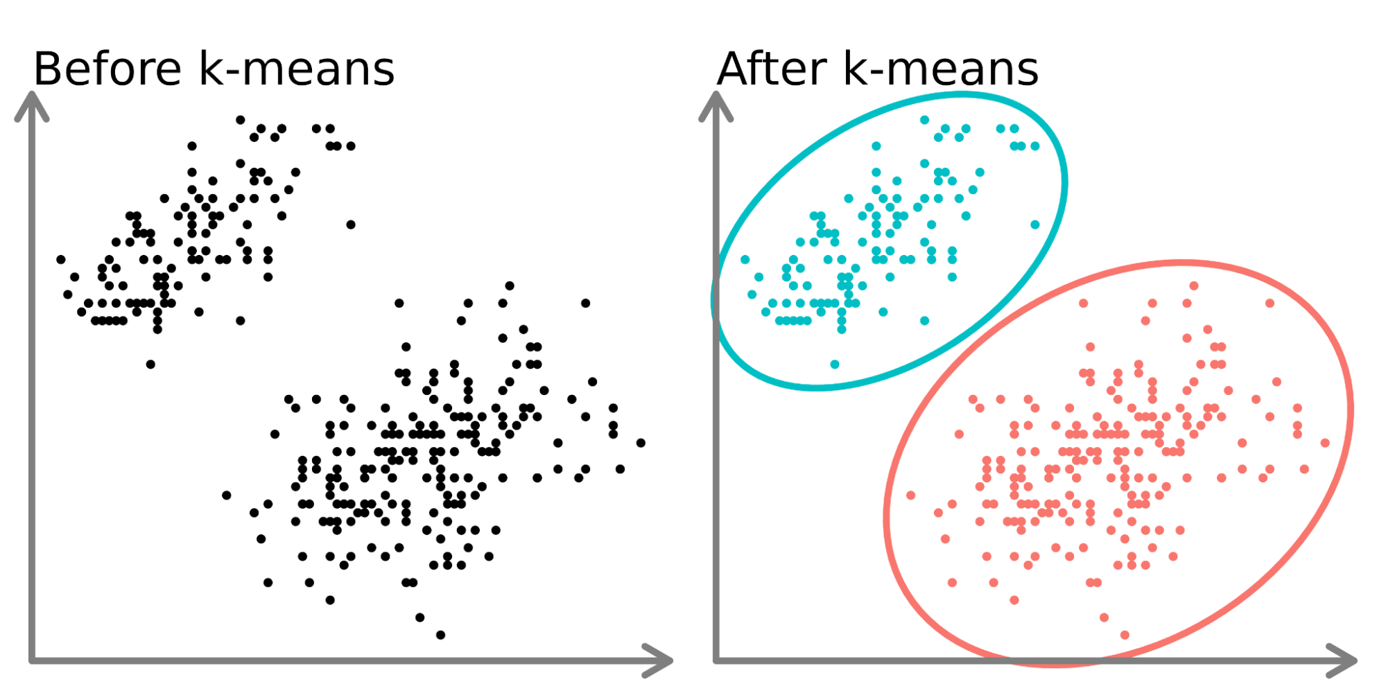
K-MEANS CLUSTERING
K-Means Clustering is an unsupervised machine learning algorithm used to partition a dataset into K distinct clusters based on feature similarity.
The algorithm works by initializing K centroids randomly, assigning each data point to the nearest centroid, and then updating the centroids based on the mean of the assigned points.
This process iterates until convergence, meaning the centroids no longer change significantly.

Slide 5
Advantage and Disadvantage
Advantages:
Simplicity and Ease of Implementation: K-Means is straightforward to understand and implement, making it accessible for beginners.
Scalability: It can handle large datasets efficiently and is relatively fast in terms of computation time compared to other clustering algorithms.
Adaptability: K-Means can be adapted to different types of data and is widely used in various applications such as market segmentation, image compression, and pattern recognition.
Works Well with Spherical Clusters: It performs well when clusters are spherical and evenly sized.
Disadvantages:
Choosing K: The number of clusters (K) must be specified in advance, which can be challenging without prior knowledge of the data.
Sensitivity to Initialization: The final clusters can depend on the initial placement of centroids, which can lead to different results in different runs.
Assumes Equal Cluster Sizes: K-Means tends to assume that all clusters have the same size and density, which may not be true for many datasets.
Only Works with Numeric Data: K-Means is not suitable for categorical data without appropriate preprocessing.

Slide 6
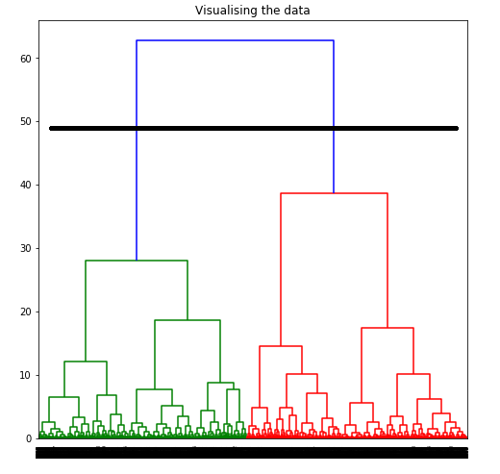
AGGLOMERATIVE CLUSTERING
Agglomerative Clustering is a type of hierarchical clustering algorithm that builds a hierarchy of clusters by iteratively merging smaller clusters into larger ones.
It starts with each data point as its own cluster and repeatedly combines the two closest clusters based on a chosen distance metric (such as Euclidean distance) until all points are merged into a single cluster or until a specified number of clusters is achieved.

Slide 7
Advantage and Disadvantage
Advantages:
No Need to Specify the Number of Clusters: Unlike K-Means, agglomerative clustering does not require the number of clusters to be defined in advance, allowing for a more flexible approach.
Hierarchical Structure: It produces a dendrogram (a tree-like structure) that provides insights into the data's structure, showing how clusters are nested.
Works Well with Non-Spherical Clusters: It can effectively cluster non-spherical shapes and varying densities, unlike K-Means.
Disadvantages:
Dendrogram Interpretation: While the hierarchical structure is informative, it can be complex to interpret, especially in larger datasets.
Merger Decisions Can Be Arbitrary: The choice of distance metric and linkage criterion can heavily influence the resulting clusters, which may introduce bias.

Slide 8
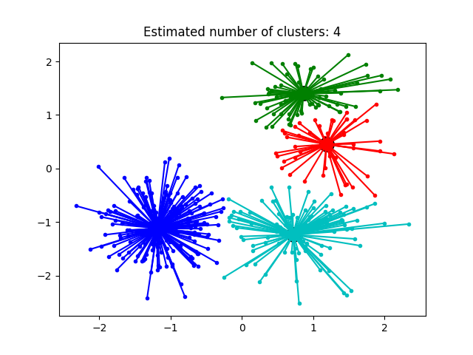
AFFINITY PROPAGATION CLUSTERING
Affinity Propagation creates clusters by sending
messages between pairs of samples until
convergence.
A dataset is then described using a small number of
exemplars, which are identified as those most
representative of other samples.
Affinity Propagation works based on similarities
between data points
Identifies a set of cluster center that represents
the dataset

Slide 9
Advantage and Disadvantage
Advantages:-
Has better performance and lower clustering error
Disadvantages:-
It is quite slow and memory-heavy, making it difficult to scale to larger datasets. We do not have any direct control on the number of clusters but in some applications, we need a specific number of clusters.
It also assumes the true underlying clusters are globular

Slide 10
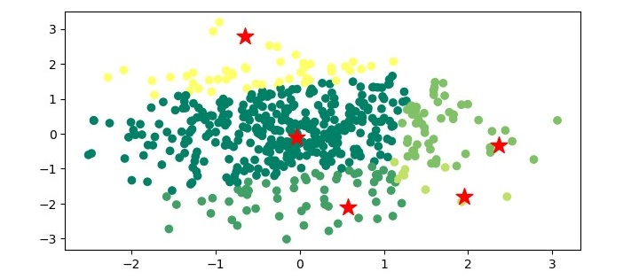
Mean-Shift clustering
Mean-shift algorithm basically assigns the datapointsto the clusters iteratively by shifting points towards the highest density of datapoints i.e. cluster centroid.
The difference between K-Means algorithm and Mean-Shift is that later one does not need to specify the number of clusters in advance because the number of clusters will be determined by the algorithm
The steps involved in the Mean-Shift clustering algorithm are as follows −
Initialize the mean of each data point to its own value.
For each data point, compute the mean shift vector, which is the tor that points towards the densest area of the data.
Update the mean of each data point by shifting it towards the densest area of the data.
Repeat steps 2 and 3 until convergence is reached.

Slide 11
Advantage and Disadvantage
Advantages:-
It does not need to make any model assumption as like in K-means or Gaussian mixture.
It can also model the complex clusters which have nonconvex shape.
It only needs one parameter named bandwidth which automatically determines the number of clusters.
There is no issue of local minima as like in K-means.
No problem generated from outliers.
Disadvantages:-
Mean-shift algorithm does not work well in case of high dimension, where number of clusters changes abruptly.
We do not have any direct control on the number of clusters but in some applications, we need a specific number of clusters.
It cannot differentiate between meaningful and meaningless modes.

Slide 12
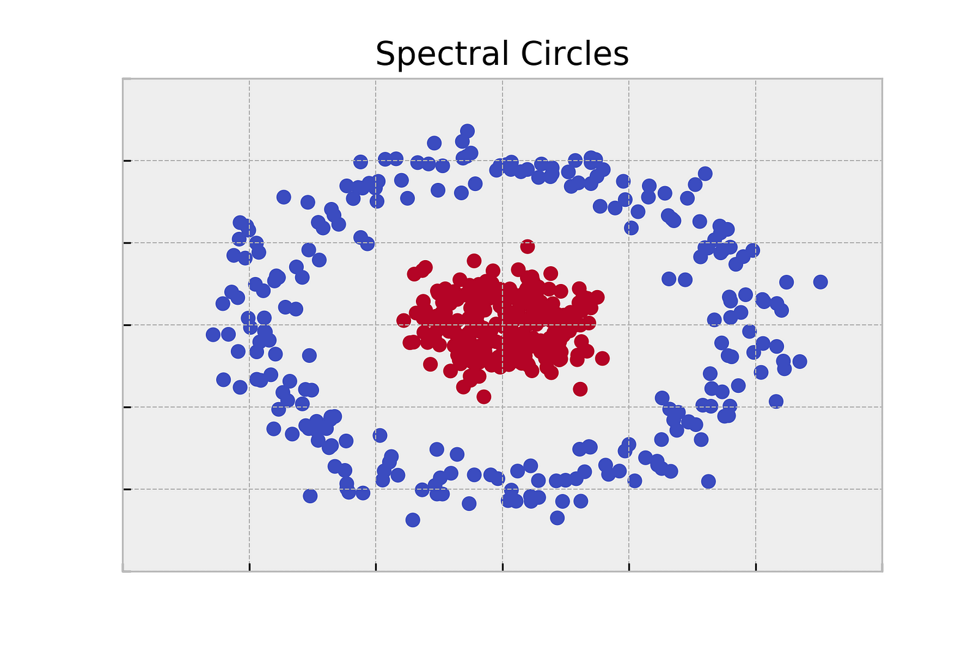
SPECTRAL CLUSTERING
In spectral clustering, data points are treated as nodes of a graph. Thus, spectral clustering is a graph partitioning problem.
The nodes are then mapped to a low-dimensional space that can be easily segregated to form clusters. No assumption is made about the shape/form of the clusters.
The goal of spectral clustering is to cluster data that is connected but not necessarily compact or clustered within convex boundaries.
Spectral co-clustering is a type of clustering algorithm that is used to find clusters in both rows and columns of a data matrix simultaneously. This is different from traditional clustering algorithm, which only cluster the rows or columns of a data matrix.

Slide 13
Advantage and Disadvantage
Advantages:-
Applicable for high dimensional datasets. One of the main advantages that spectral clustering has over other clustering algorithms is that it can be used on high-dimensional datasets with many features.
Not strong assumptions about cluster shape. Spectral clustering does not make strong assumptions about the shape of the clusters in the data. That means that it is appropriate to use spectral clustering even when you suspect the clusters in your data may be irregularly shaped.
Can sometimes handle categorical variables. Some implementations of spectral clustering can handle cases where you have mixed data types, such as cases where you have categorical variables in your data. This is in part because spectral clustering uses similarity metrics rather than distance metrics to determine which points have more in common.
Disadvantages:-
Relatively slow. One disadvantage of spectral clustering is that it is relatively slow compared to other clustering algorithms like k-means clustering.
If you have a dataset with many, many data points then you may be better off using a faster algorithm.
Need to select the number of clusters. As with many other clustering algorithms, spectral clustering requires you to select the number of clusters that should be used for your dataset. This can be difficult to do if you do not have strong intuition about the true number of clusters in the data.

Slide 14
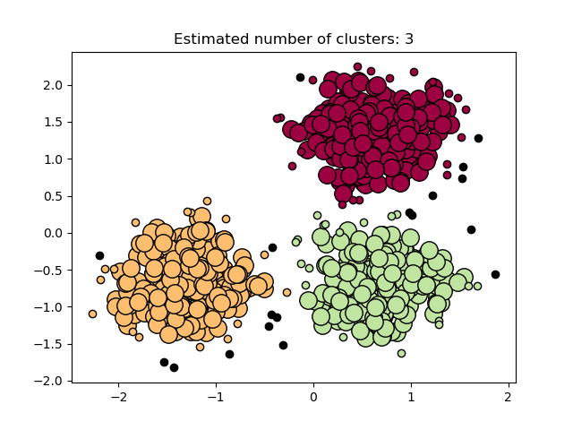
DBSCAN CLUSTERING
Density-Based Spatial Clustering of Applications with Noise - (DBSCAN) clustering.
DBSCAN is a density-based clustering algorithm that works on the assumption that clusters are dense regions in space separated by regions of lower density. It groups 'densely grouped' data points into a single cluster.
Any core sample is part of a cluster, by definition. Any sample that is not a core sample, and is at least eps in distance from any core sample, is considered an outlier by the algorithm.
In the figure below, the color indicates cluster membership, with large circles indicating core samples found by the algorithm. Smaller circles are non-core samples that are still part of a cluster. Moreover, the outliers are indicated by black points below.

Slide 15
Advantage and Disadvantage
Advantages:-
DBSCAN is great at separating high-density clusters from low-density clusters,
DBSCAN can be used to detect clusters that are oddly or irregularly shaped, such as clusters that are ring-
shaped.
DBSCAN is used to handle clusters of multiple sizes and structures and is not powerfully influenced by
noise or outliers.
Disadvantages:-
DBSCAN struggles with clusters of similar density.
Struggles with high dimensionality data. If given data with too many dimensions, DBSCAN suffers.

Slide 16
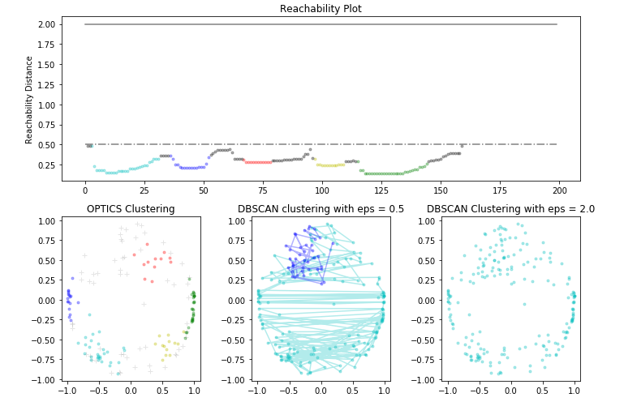
OPTICS CLUSTERING
Ordering Points To Identify Cluster Structure - (OPTICS)
OPTICS is a density-based clustering algorithm, similar to DBSCAN, but it can extract clusters of varying densities and shapes.
The main idea behind OPTICS is to extract the clustering structure of a dataset by identifying the density-connected points.
The algorithm builds a density-based representation of the data by creating an ordered list of points called the reachability plot. Each point in the list is associated with a reachability distance, which is a measure of how easy it is to reach that point from other points in the dataset. Points with similar reachability distances are likely to be in the same cluster.
Note that for any single value of eps, DBSCAN will tend to have a shorter run time than OPTICS; however, for repeated runs at varying eps values, a single run of OPTICS may require less cumulative runtime than DBSCAN. It is also important to note that OPTICS’ output is close to DBSCAN’s only if eps and max_eps are close.

Slide 17
Advantage and Disadvantage
Advantages
OPTICS clustering doesn't require a predefined number of clusters in advance
Clusters can be of any shape, including non-spherical ones
Disadvantages
It fails if there are no density drops between clusters
It is also sensitive to parameters that define density (radius and the minimum number of points) and proper parameter settings require domain knowledge.

Slide 18
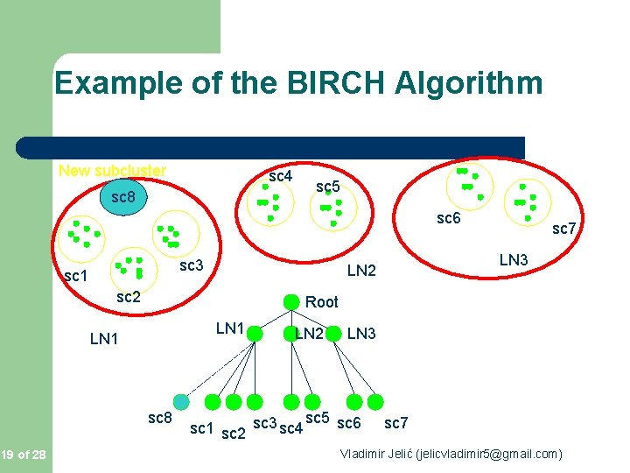
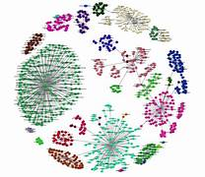
BIRCH CLUSTERING
Balanced Iterative Reducing and Clustering using Hierarchies - (BIRCH)
Clustering algorithms like K-means clustering do not perform clustering very efficiently and it is difficult to process large datasets with a limited amount of resources. So, regular clustering algorithms do not scale well in terms of running time and quality as the size of the dataset increases.This is where BIRCH clustering comes in.
BIRCH clustering algorithm can cluster large datasets by first generating a small and compact summary of the large dataset that retains as much information as possible. This smaller summary is then clustered instead of clustering the larger dataset.
The BIRCH algorithm has two parameters, the threshold and the branching factor. The branching factor limits the number of subclusters in a node and the threshold limits the distance between the entering sample and the existing subclusters.

Slide 19
Advantage and Disadvantage
Advantages
BIRCH is useful for performing precise Clustering on large datasets
An main advantage of BIRCH is its ability to incrementally and dynamically cluster incoming, multi-
dimensional metric data points to produce the best quality clustering for a given set of resources (memory and time constraints). In most cases, BIRCH only requires a single scan of the database.
Disadvantages
BIRCH has one major drawback, it can only process metric attributes. A metric attribute is an attribute whose values can be represented in Euclidean space, i.e., no categorical attributes should be present.

Slide 20
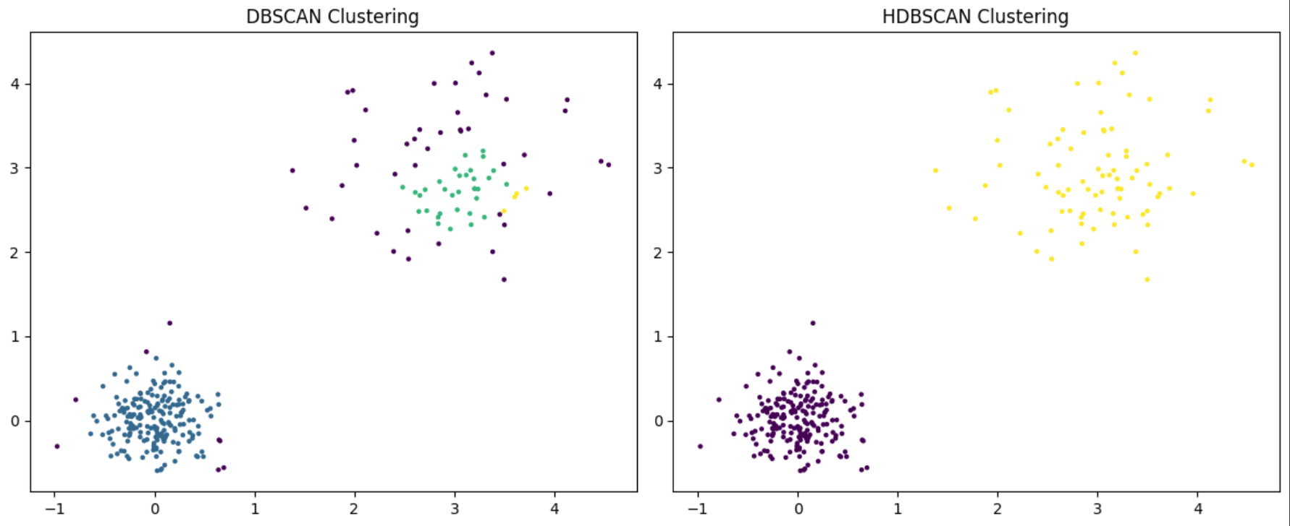
HDBSCAN CLUSTERING
The HDBSCAN algorithm can be seen as an extension of DBSCAN and OPTICS. Specifically, DBSCAN assumes that the clustering criterion (i.e. density requirement) is globally homogeneous. In other words, DBSCAN may struggle to successfully capture clusters with different densities. HDBSCAN alleviates this assumption and explores all possible density scales by building an alternative representation of the clustering problem.
Difference Between DBSCAN and HDBSCAN:
DBSCAN: • Requires setting parameters like eps and min_samples.
• Clusters are determined based on density, and points are labeled as noise if they do not belong to any cluster.
• The number of clusters is not pre-defined.
• Sensitive to the choice of parameters.
HDBSCAN: • Automatically determines the number of clusters without specifying parameters like eps and min_samples.
• Utilizes a hierarchical clustering approach to identify clusters at different levels of density.
• More robust to varying densities and shapes of clusters.
• Produces a hierarchical cluster structure.

Slide 21
Advantage and Disadvantage
Advantages:
Handles Varying Densities: HDBSCAN can identify clusters of different shapes and sizes, making it suitable for real-world datasets with varying densities.
Robust to Noise: It effectively distinguishes noise from clusters, which enhances the quality of the clustering results.
No Need to Specify Cluster Number: Unlike K-Means, HDBSCAN does not require the number of clusters to be predetermined. It can find the optimal number of clusters based on the data.
Efficient for Large Datasets: The algorithm is designed to be efficient and can handle large datasets with good performance.
Disadvantages:
Parameter Sensitivity: HDBSCAN has parameters (such as minimum cluster size and minimum samples) that need to be carefully tuned, and inappropriate choices can lead to suboptimal clustering.
Complexity of Interpretation: The hierarchical structure and results can be complex to interpret, especially for users unfamiliar with density-based clustering.
Computationally Intensive: While it is more efficient than DBSCAN for large datasets, HDBSCAN can still be resource-intensive and slower than simpler algorithms like K-Means, especially with very large datasets.
Limited to Density-Based Clustering: It may not perform well with clusters that do not have clear density distinctions or with certain types of high-dimensional data.

Slide 22
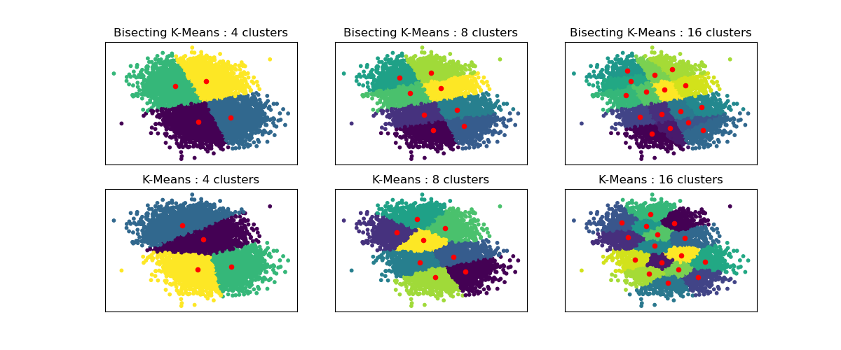
Bisecting K-Means Clustering
Bisecting K-Means is a hierarchical clustering method that combines the benefits of K-Means and hierarchical clustering.
It begins by treating all data points as a single cluster and then recursively divides it into two clusters using the K-Means algorithm.
This process continues until the desired number of clusters is reached. The choice of which cluster to split at each step is often based on factors like cluster size or the variance within the cluster.

Slide 23
Advantage and Disadvantage
Advantages:
Combines Benefits of K-Means and Hierarchical Clustering: Bisecting K-Means can yield high-quality clusters while also providing a hierarchical view of the data.
More Efficient than Traditional Hierarchical Methods: It is generally faster and more scalable than traditional agglomerative hierarchical clustering, especially for large datasets.
Flexibility in Cluster Number: The algorithm allows for a more straightforward way to define the number of clusters while maintaining the hierarchical aspect.
Improved Results with K-Means: By using K-Means for the bisecting step, it can produce tighter clusters compared to some other hierarchical methods.
Disadvantages:
Choice of Initial Clusters: The results can depend on the initial selection of clusters and the order in which clusters are split.
Computational Cost: While more efficient than full hierarchical methods, it can still be computationally intensive, especially if K-Means is run multiple times.
Complexity in Interpretation: The resulting hierarchy may be complex to interpret, especially if the number of desired clusters is large.

